Slide 1
Step Detection using SVM on NURVV Trackers
Didier Lopes, Grant Trewartha
13 December of 2021

Slide 2
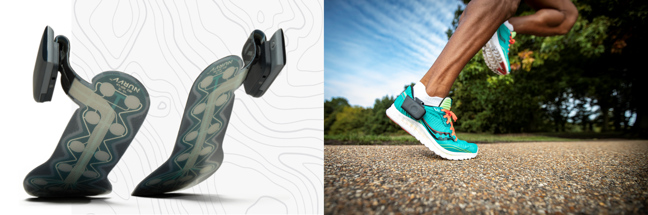
NURVV TRACKERS AND DATA
NURVV Trackers
NURVV Run is a foot-based wearable technology product for runners (www.nurvv.com) launched to the consumer market in early 2020.
NURVV Run hardware contains: 2 thin smart insoles with 16 FSRs, a GNSS receiver, a barometer, a 6-axis IMU and a 3-axis high-G accelerometer.

Slide 3
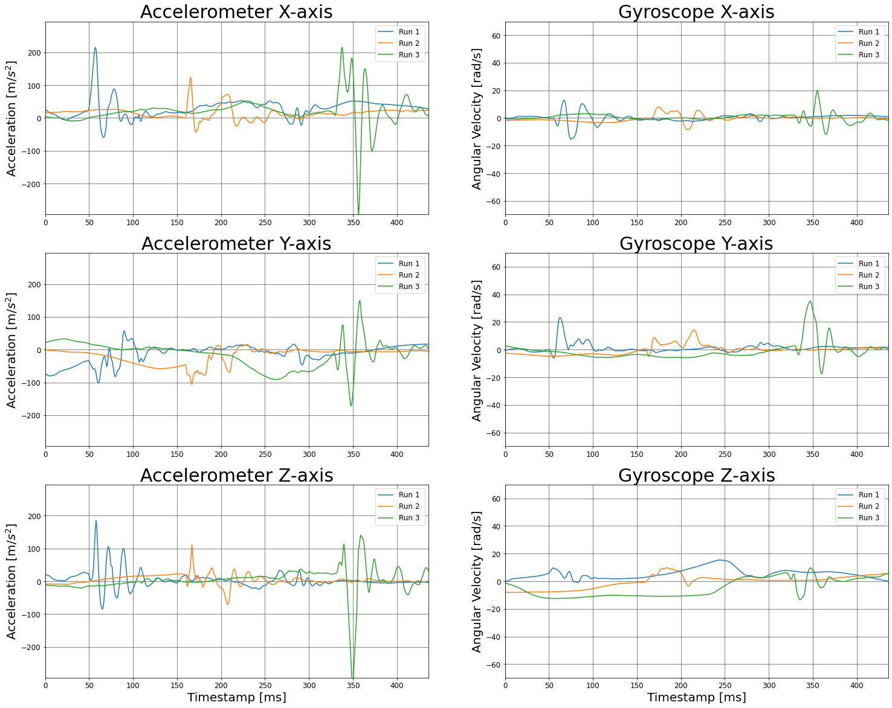
NURVV TRACKERS AND DATA
IMU Data Set
For this work we will focus on the InvenSense ICM-20649 (i.e. 6-axis IMU data sampled at 1125 Hz), which corresponds to the acceleration and angular velocity.
NURVV gave us access to 6 different datasets (distinct runners on different terrains with different shoes).
This data diversity can be seen on the right where we can see the behaviour of the 6-axis IMU samples at the moment of a step given by 3 different runs. Hence, showing the difficulty of the task we have at hands.

Slide 4
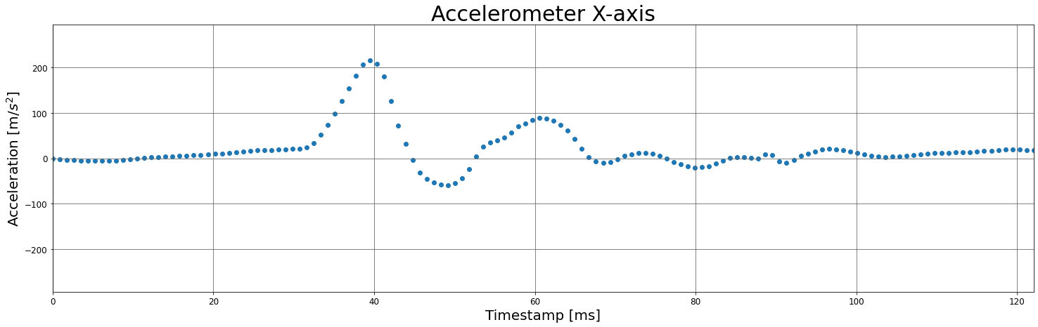
NURVV TRACKERS AND DATA
IMU Data Set
The IMU data has a sampling rate of 1125 Hz, which means that each data point gets sampled at approximately every 888.89μs.
Given the problem we are facing, this fast-sampling rate is critical, because it ensures that no sensor oscillations are missed, and it gives some safe margin error for the sample classification problem.

Slide 5
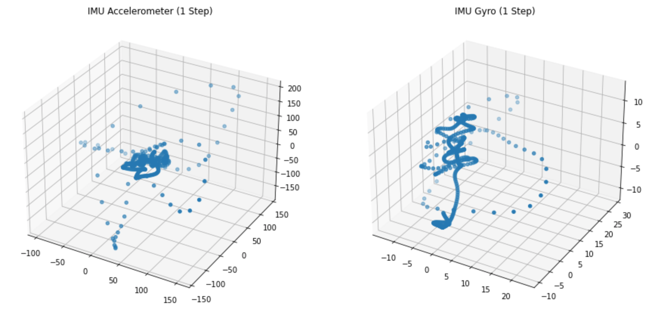
LABELLING DATA FOR A SUPERVISED PROBLEM
Exploratory Data Analysis
Acceleration and angular velocity vectors in 3D as a function of time during the occurrence of a step.

Slide 6
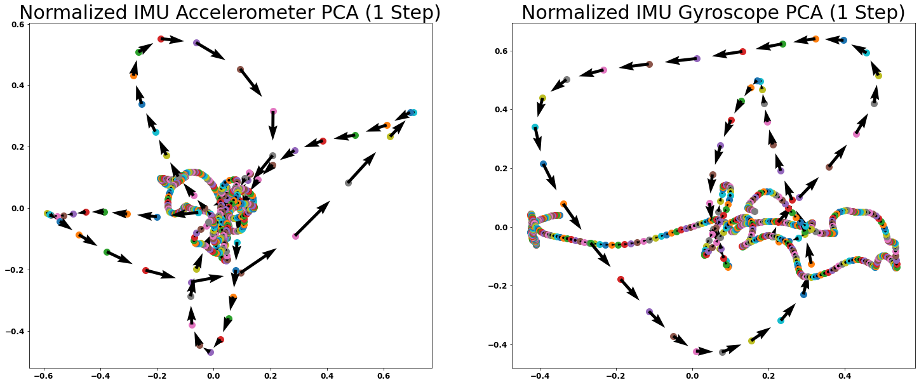
LABELLING DATA FOR A SUPERVISED PROBLEM
Exploratory Data Analysis
PCA applied to acceleration and angular velocity as a function of time during the occurrence of a step. The arrows denote the flow of time.

Slide 7
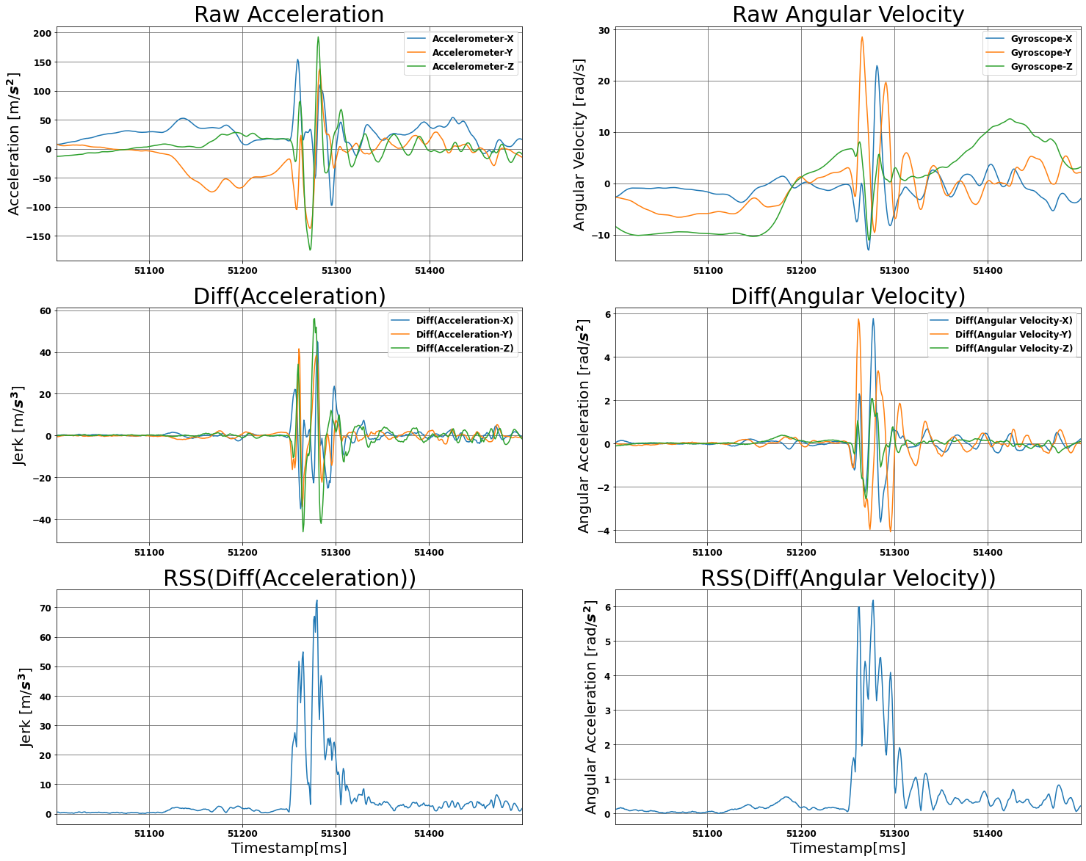
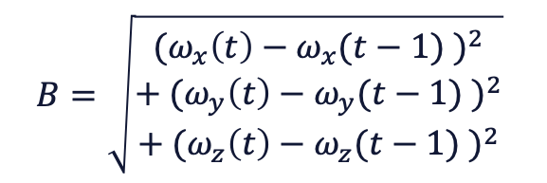
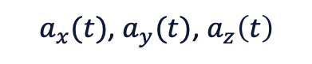
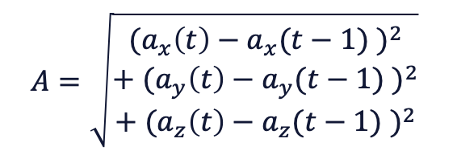
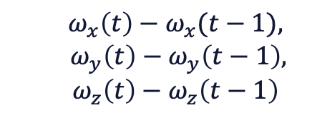
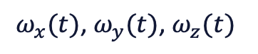
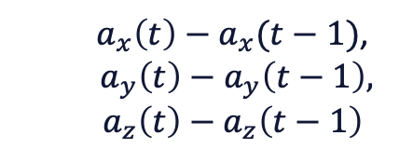
LABELLING DATA FOR A SUPERVISED PROBLEM
Signal Processing
$a_{x}(t)$, $a_{y}(t)$, $a_{z}\left(t\right)$
$$ω_{x}(t)\text{,} ω_{y}(t)\text{,} ω_{z}(t)$$
$a_{x}\left(t\right)−a_{x}(t−1)$,
$a_{y}\left(t\right)−a_{y}\left(t−1\right),$
$$a_{z}\left(t\right)−a_{z}\left(t−1\right)$$
$$ω_{x}\left(t\right)−ω_{x}(t−1),$$
$ω_{y}\left(t\right)−ω_{y}\left(t−1\right),$
$$ω_{z}\left(t\right)−ω_{z}\left(t−1\right)$$
$$B=\sqrt{\begin{aligned}{(ω_{x}\left(t\right)−ω_{x}(t−1) )}^{2} \\ + {(ω_{y}\left(t\right)−ω_{y}(t−1) )}^{2} \\ + {(ω_{z}\left(t\right)−ω_{z}(t−1) )}^{2}\end{aligned}}$$
$$A=\sqrt{\begin{aligned}{(a_{x}\left(t\right)−a_{x}(t−1) )}^{2} \\ + {(a_{y}\left(t\right)−a_{y}(t−1) )}^{2} \\ + {(a_{z}\left(t\right)−a_{z}(t−1) )}^{2}\end{aligned}}$$

Slide 8
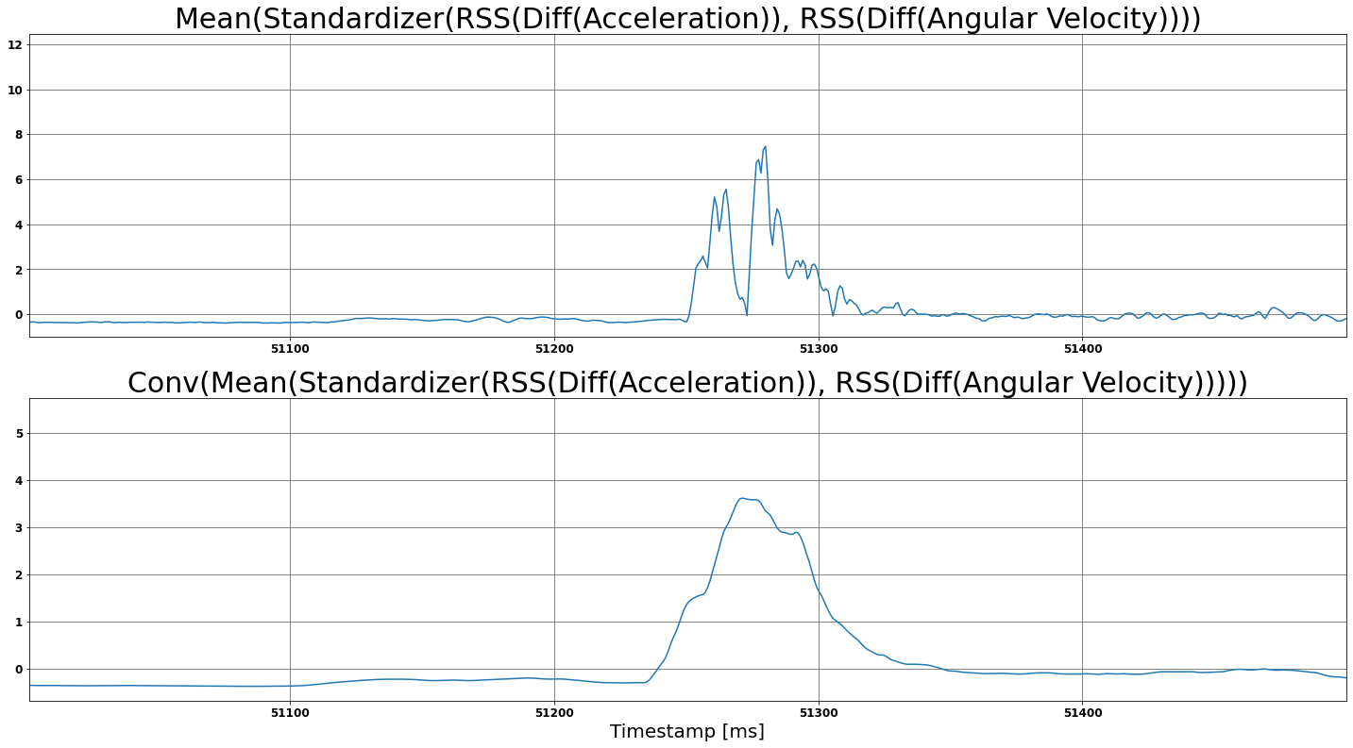
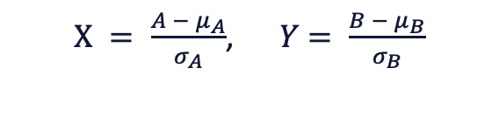


LABELLING DATA FOR A SUPERVISED PROBLEM
Signal Processing
$X = \frac{A − μ_{A}}{σ_{A}}$, $Y$ $= \frac{B − μ_{B}}{σ_{B}}$
$$Z =\frac{X+Y}{2}$$
$$f\left(t\right)= z\left(t\right) ∗g(t)$$
Where g(t) is a rectangular pulse of 40 samples with magnitudes of 1/40.

Slide 9
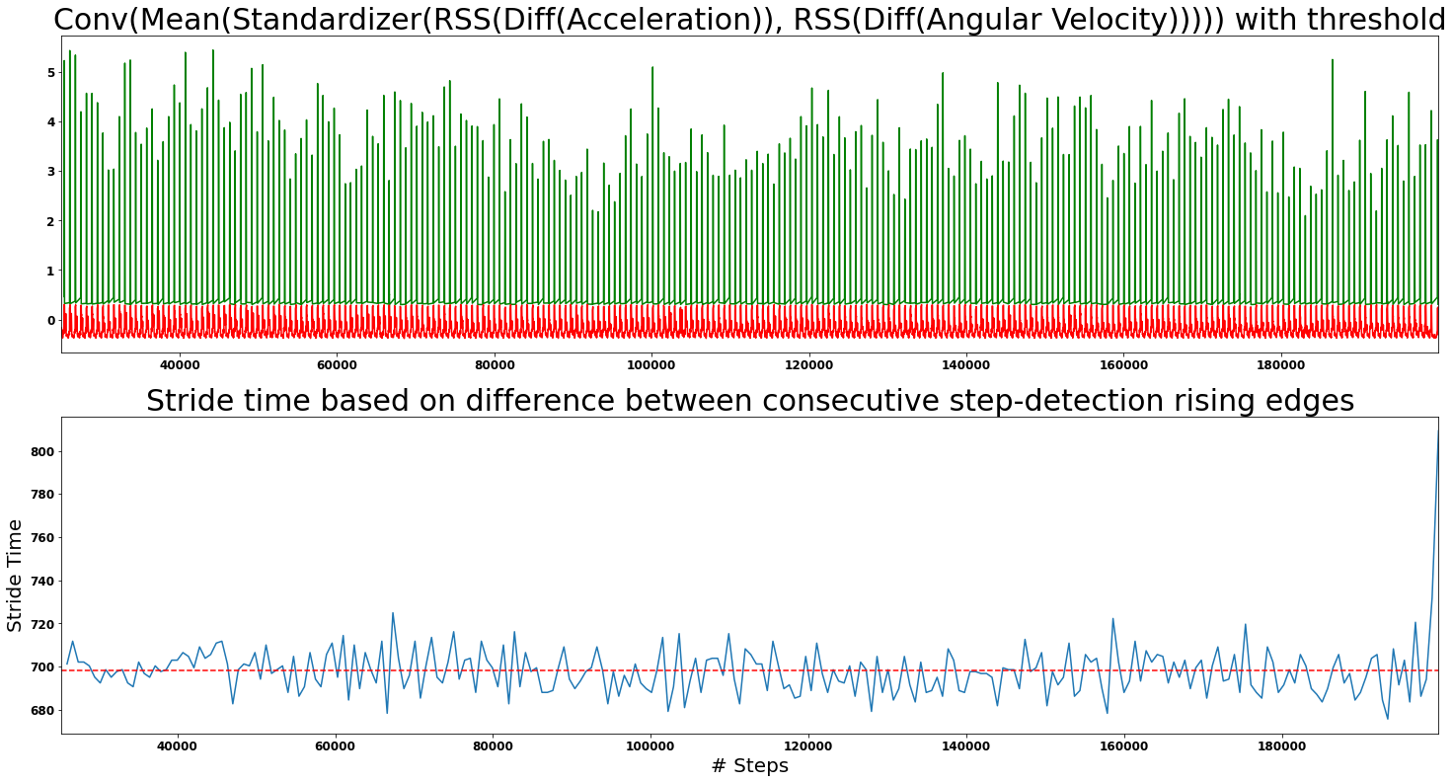
LABELLING DATA FOR A SUPERVISED PROBLEM
Signal Processing
On the signal f(t) generated a value of 0.3
was used as a threshold to classify step vs no-step.
Based on this classification we calculated the stride times based on the first sample that went from no-step to step.
Given that all the stride times fall around 700ms this implies that no steps were missed and the threshold value of 0.3 was a good choice.

Slide 10
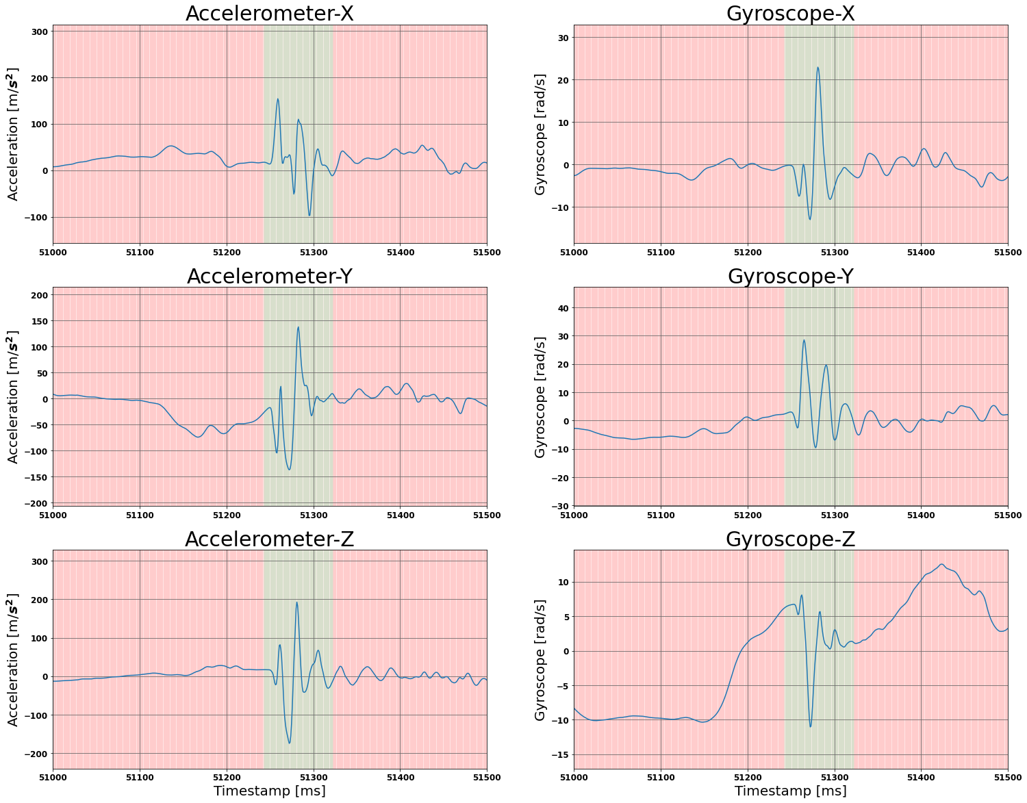
LABELLING DATA FOR A SUPERVISED PROBLEM
Signal Processing
Raw IMU data against labelling from Signal Processing approach (red background means no step, while green background means step).

Slide 11
SVM FOR CLASSIFICATION
Model Selection
SVM with RBF kernel
SVM works well with high dimensional data (6 IMU samples) because only uses a few of these points (called support vectors) to create this hyperplane (decision boundary) between classes.
SVM is ideal for binary classification problems.
RBF kernel allows to handle non-linear data.

Slide 12
SVM FOR CLASSIFICATION
Hyperparameters Optimization
C and gamma hyperparameters
Given each dataset is rather large to perform grid search optimization on C and gamma, a subset of each of the datasets is used to extract these parameters.
Each dataset subset is now split: 80% for training data and 20% for validation.
Thus, 80% of the data subset is used to apply SVM with different combinations of C and gamma over a 2D grid. The remaining 20% is used to test the logistic loss and assess optimal hyperparameters.

Slide 13
SVM FOR CLASSIFICATION
Training and Testing
80% of data is used for training and 20% is used for testing.
Although the testing is done out-of-sample, given the nature of the data (where it comes from the same distribution) it is almost as if it was an in-sample.
In our case this is ideal as we want each model to perform very well on its own dataset. We want each model to generalize well for that very specific type of data (runner style, speed and terrain).
A 5-sample moving average is applied before assessing the classification of our model, this is to remove spurious samples. A small window needs to be selected to not introduce a delay in the recognition of a step.

Slide 14
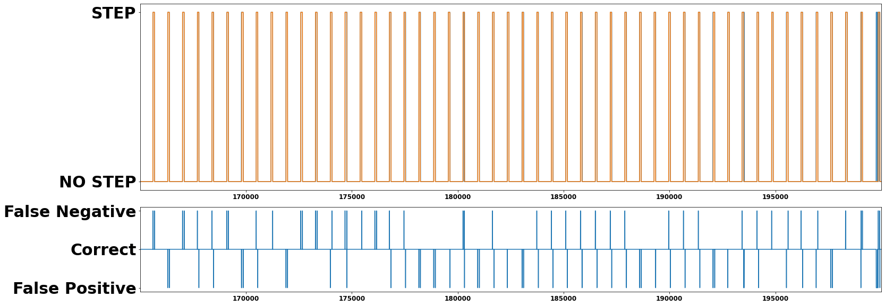
SVM FOR CLASSIFICATION
Results
Out of 39830 samples on the testing set (20% of original dataset), our SVM model had:
376 false positives (detecting step when it wasn’t)
213 false negatives (failing to recognize a step)
From the graph above this result is very positive given that the mislabelling always occurs at the boundary of a step / no-step detection. And since the sampling occurs very fast, we have some margin of error.

Slide 15
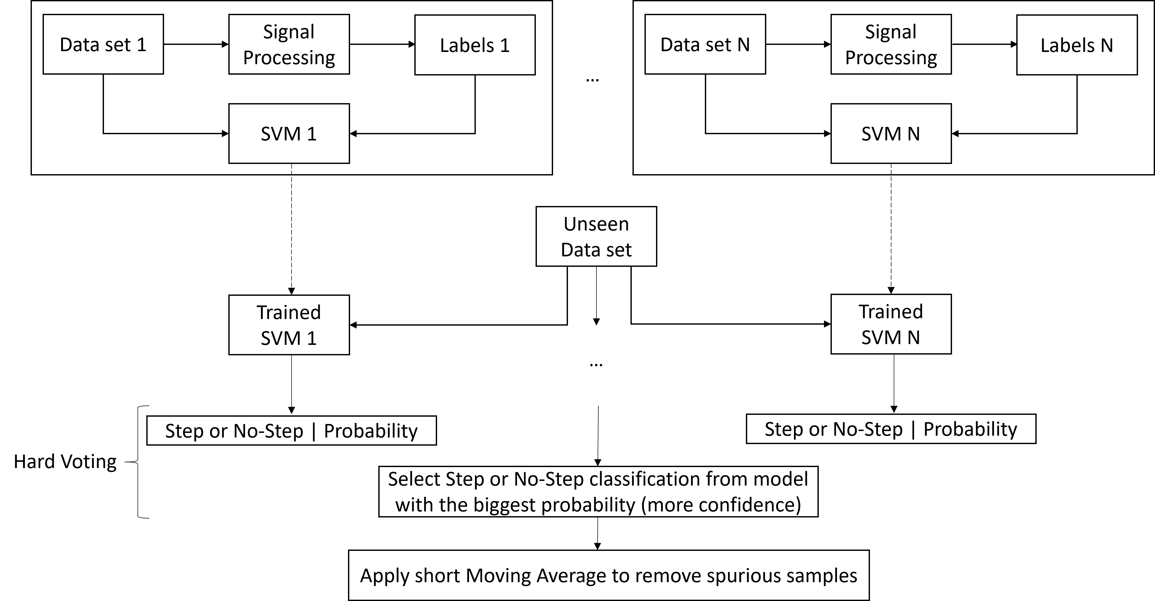
ENSEMBLE SVM MODEL FOR STEP DETECTION
Ensemble SVM model Architecture

Slide 16
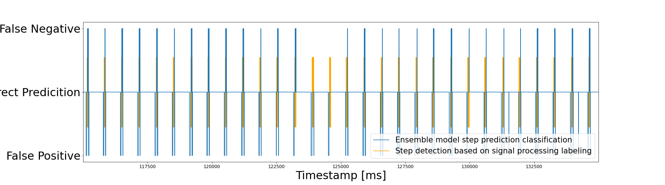
RESULTS AND ANALYSIS
Since our data set is imbalanced (i.e. there are more samples being no-step than step samples) we need to choose an evaluation metric accordingly. For that reason, we'll use Geometric Mean (G-Mean) score, since this measure tries to maximize the accuracy on each of the classes while keeping their accuracies balanced.
The G-Mean obtained on our test set was of 0.8756, which is a good results since it's close to 1. For comparison, the G-mean obtained for the validation of one SVM model was of 0.9645, which is expected because the model was trained on such data set.

Slide 17
DISCUSSION
The prediction for a single SVM was extremely accurate because the model was trained on data samples from that same run (i.e. distribution). On the other hand, the ensemble prediction didn’t train on data from that distribution, hence, making this problem much more complex.
Nonetheless, we believe that these results are rather good, as they show that the algorithm only struggles on the transition phases from step on the ground to step in the air, and vice-versa. This struggle could be caused by the signal processing technique used in the labelling of the data

Slide 18
FUTURE WORK
Employ the data coming from the ”smart” insoles as an alternative ground-truth for determining step versus no-step conditions.
The diversity of the data set can also be expanded to account for more surfaces, running speeds and styles.
Explore whether the characteristics of the PCA plot of IMU data can be used to categorize different running styles.
The exploration of different classification algorithms for the step detection problem, e.g. applying a long-short term memory (LTSM) neural network algorithm to exploit the time-dependency between samples.
Implement this proof-of-concept code on the production NURVV Run system, to test the prediction technique in a real-life scenario and consider computational time.

Slide 19
Thank you!
All code will be made available at: https://github.com/DidierRLopes/step-detection-ML
13 December of 2021

